Slide 1

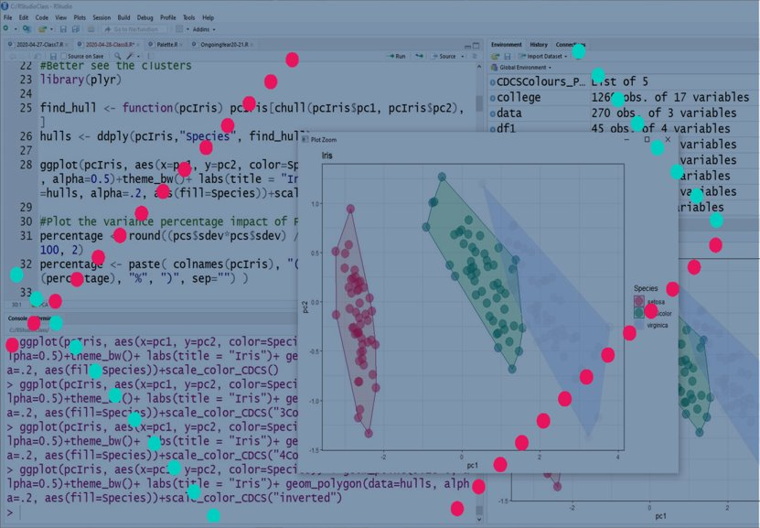
Basic Statistics and Visualisation with R
lmichiel@exseed.ed.ac.uk

Slide 2

Today Program
Types of data
How to load data in RStudio
How to choose the right graph
Graph types
The Grammar of Graphs
Ggplot2 structure
Graph settings
www.cdcs.ed.ac.uk

Slide 3

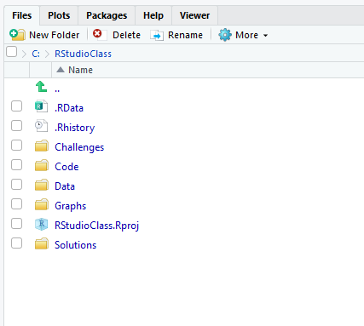
Before we started
Your workspace shall look something like this
A project folder
Within the folder a series of subfolders: Challenges, Code, Data, Graphs, Solution
A Rstudio project file
A .Rdata file and a .Rhistory file (both generated authomatically by the system
www.cdcs.ed.ac.uk

Slide 4

How to install Packages
See current packages
library()#List the available ones
search()#List the ready to go ones
Install packages
install.packages("ggplot2")
Activate packages
library(ggplot2)
Check for updates
update.packages()
To unload packages
detach ("package:ggplot2", unload = TRUE)
To Remove packages
remove.packages("nameofthepackage")
www.cdcs.ed.ac.uk

Slide 5
How to Read Data
Data types
Vector: monodimential (either a column or a row) One dimentional collection of data
Matrix: bidimential collection of data
Array: multidimentional collection of data
Data frame: different type variables (similar to a table in spreadsheet)
Reading a Table
Variables: The attributes of our dataset basically the Column
Observations: Measurements carried out in one or more individuals, based on one or more variables
www.cdcs.ed.ac.uk

Slide 6
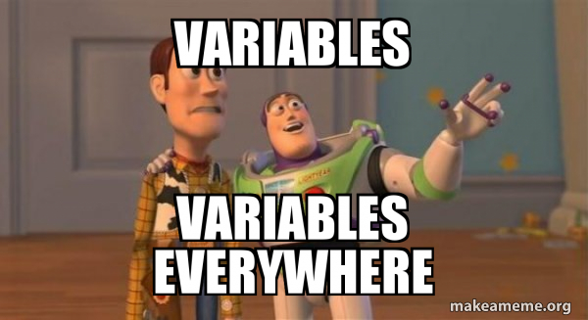
Types of variables
Categorical variables
Defined and limited values, might not have a logical order
Material: bronze, iron, ivory
Color: blu, red, white
Discrete variables
numeric variables that have a countable number of values between any two values. A discrete variable is always numeric
Number of attendees
Centuries
Continuous variables
Numeric variables that have an infinite number of values between any two values
Diameter
Lenght
www.cdcs.ed.ac.uk

Slide 7

Load data into R Studio
df <- read_csv("data/RodentSimplified.csv")
df <- read_csv("data/RodentSimplified.csv") %>%
select(mo,
dy,yr,period) %>%
mutate(period = as.factor(period)) %>%
rename(month = mo) %>%
print()
www.cdcs.ed.ac.uk

Slide 8
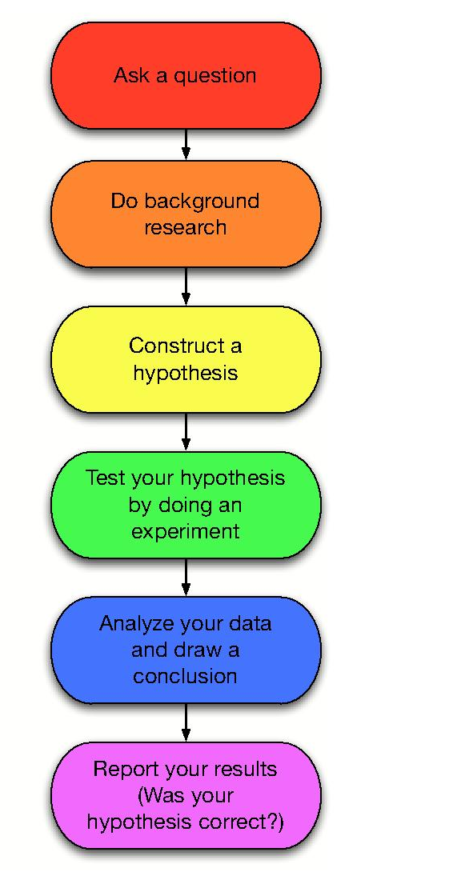

Research Question
Before Plotting
R
www.cdcs.ed.ac.uk

Slide 9
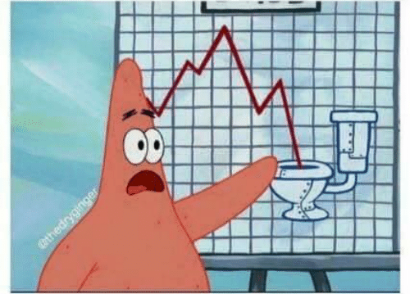
Why do you want to plot a graph?
What do you want to convey?
Analyse one variable (is it constant, does it have one or more peaks)?
Tell a story (what do you think your data can tell)?
Show a relation between two variables?
Suggest a trend?
Show a change (across time, across space, etc)?
https://datavizcatalogue.com/
www.cdcs.ed.ac.uk

Slide 10
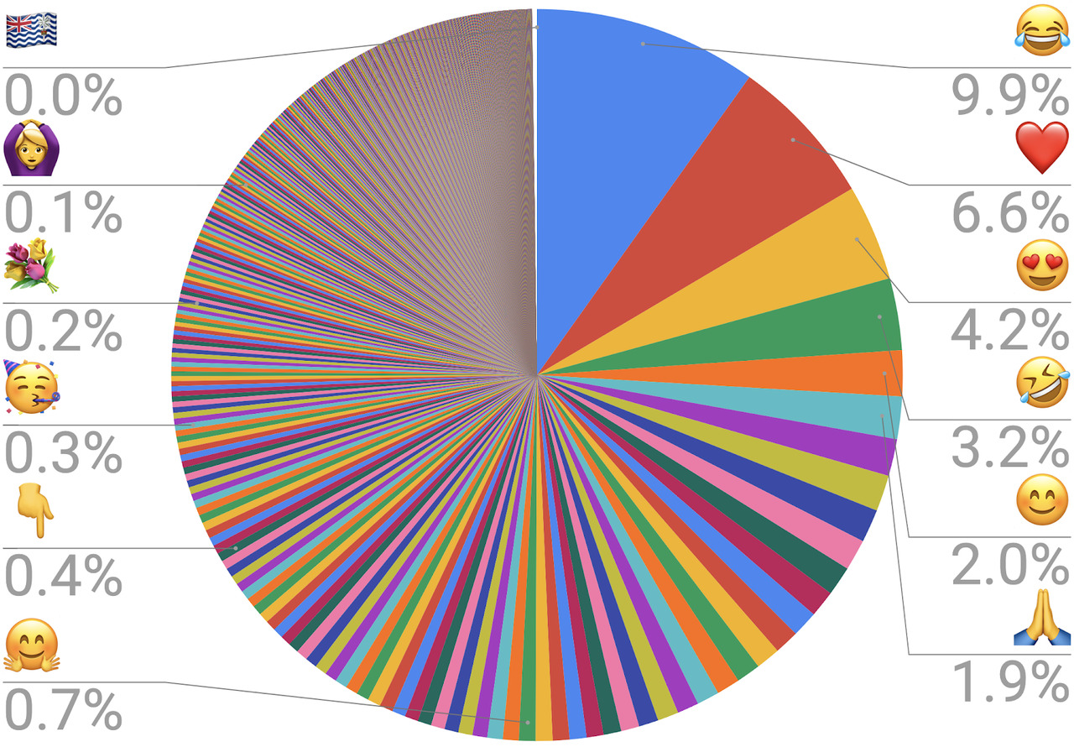
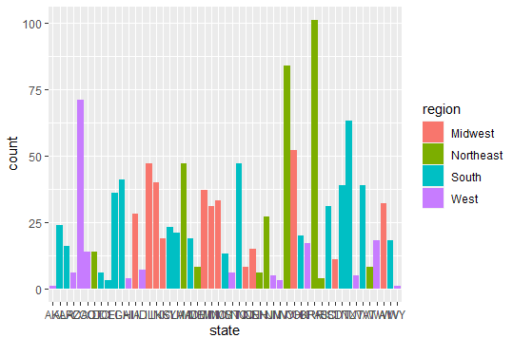

Consider the medium
Will it be printed? Visualized online…?
How big will it be?
How can I improve the understanding?
www.cdcs.ed.ac.uk

Slide 11
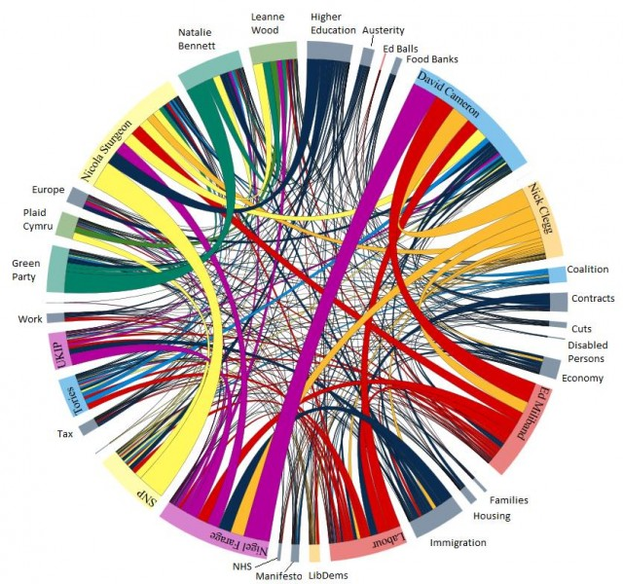
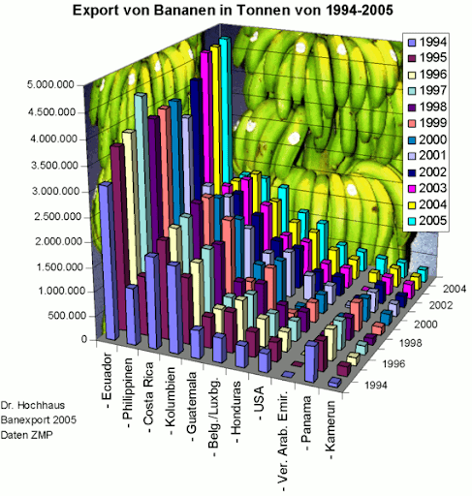
Avoid Showing off
www.cdcs.ed.ac.uk

Slide 12
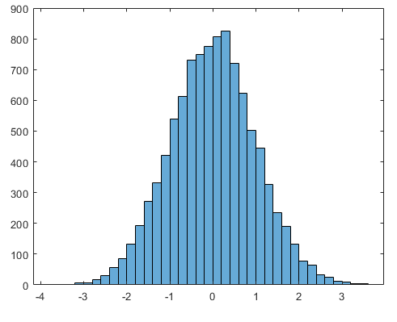
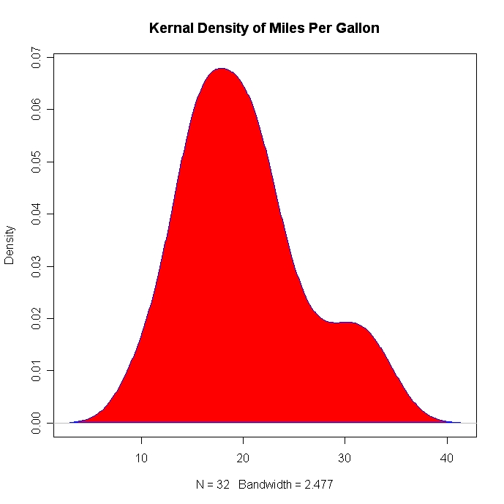
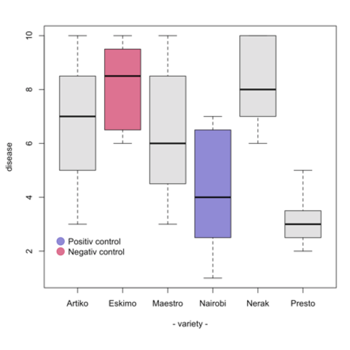
Distribution
Histogram
Density Plot
Boxplot
www.cdcs.ed.ac.uk

Slide 13
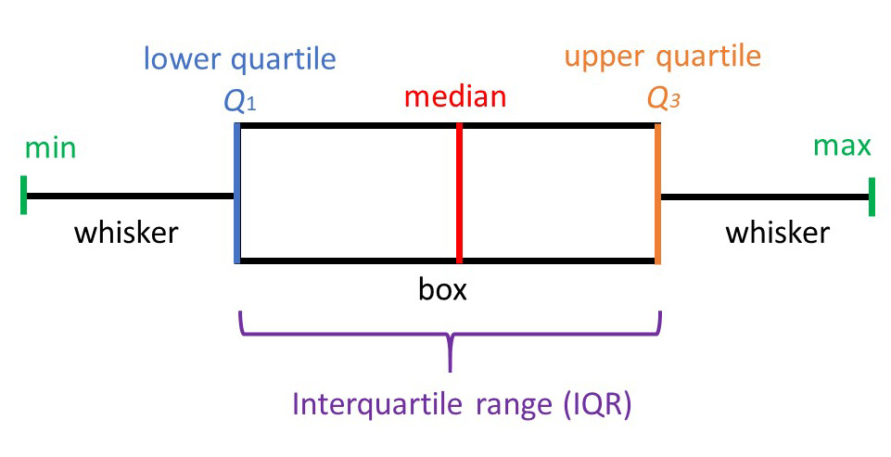
Box Plot
www.cdcs.ed.ac.uk

Slide 14
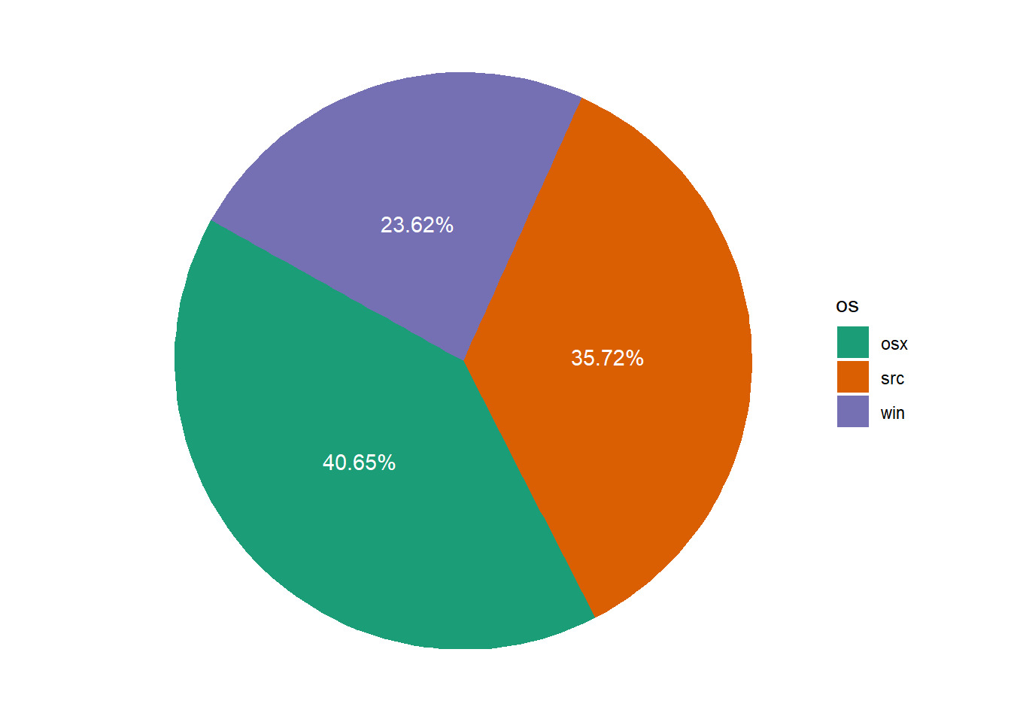
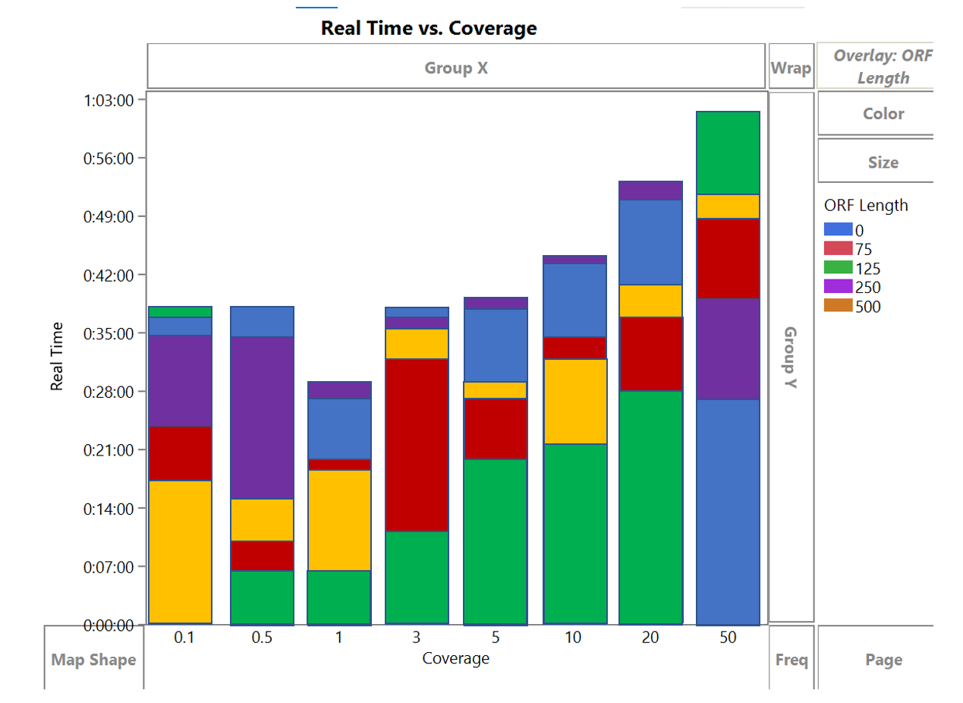
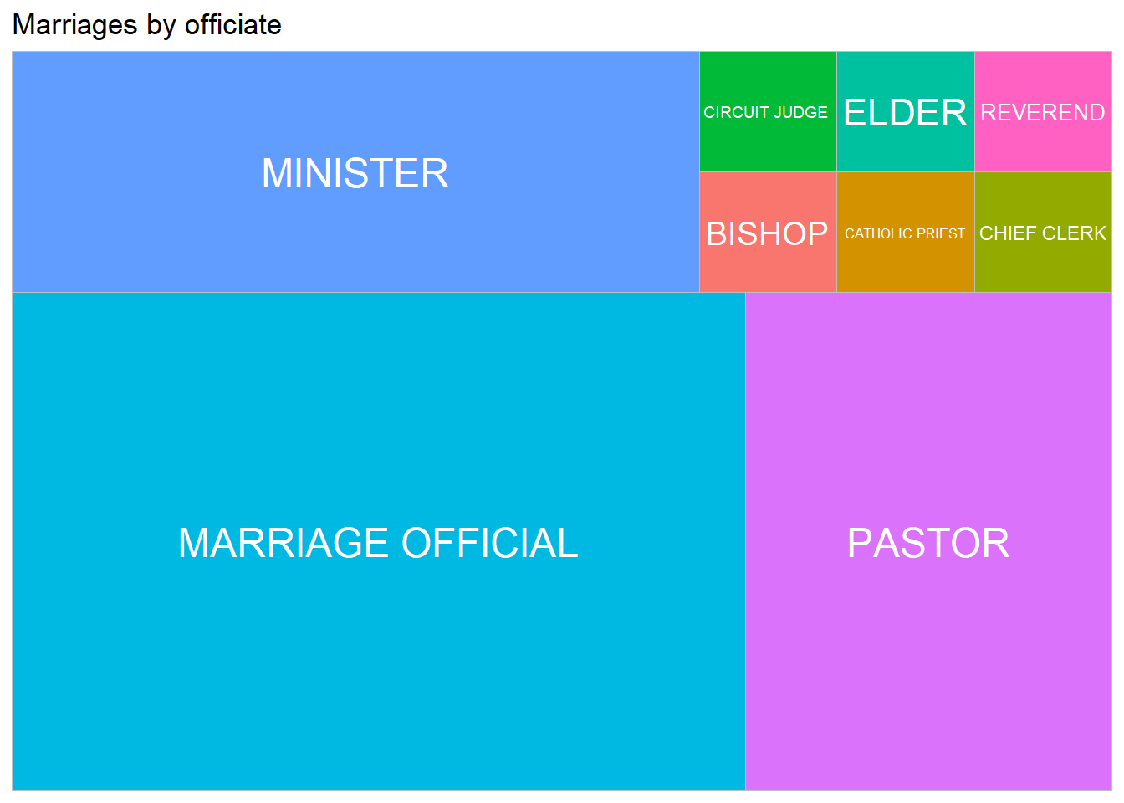
Ratios
Piechart
Stacked bar graph
Treemap
www.cdcs.ed.ac.uk

Slide 15
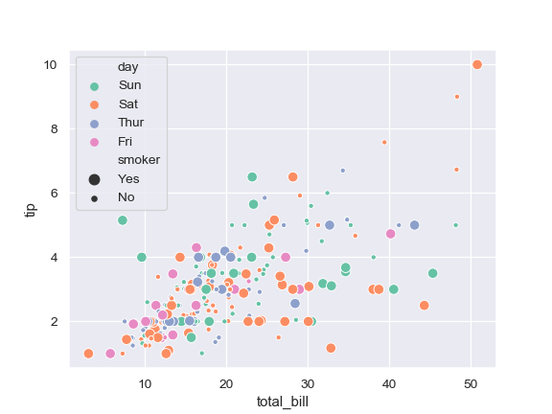
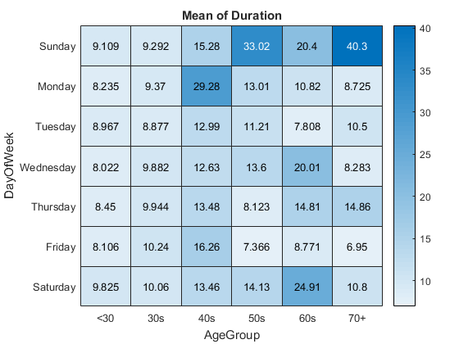
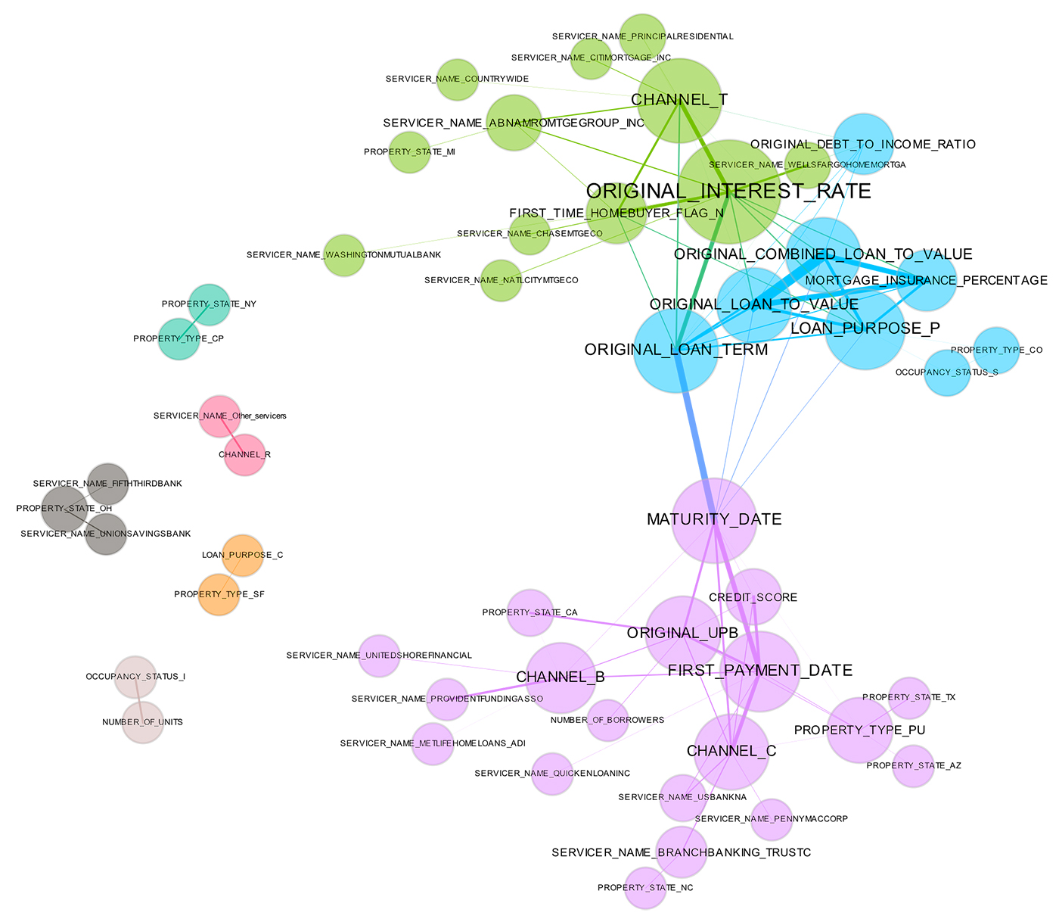
Relations
Scatter plot
Heatmap
Network diagram
www.cdcs.ed.ac.uk

Slide 16
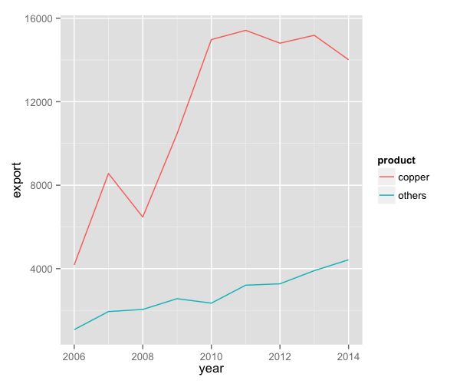
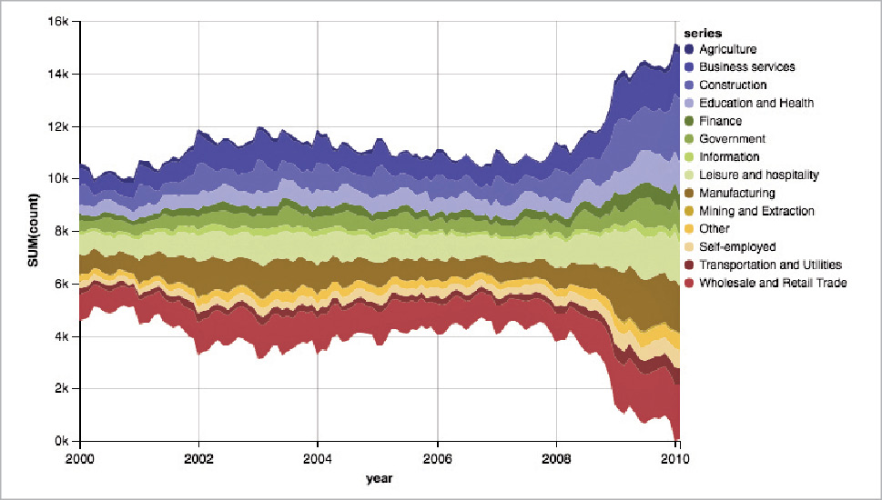
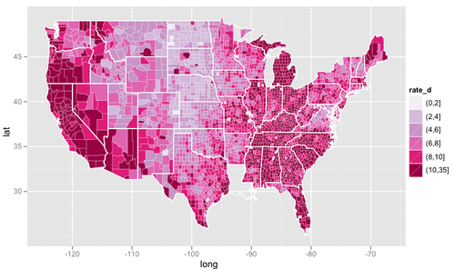
Change
Line graph
Stream graph
Choropleth map
www.cdcs.ed.ac.uk

Slide 17
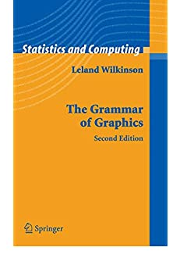
The Grammar of Graphics
Sentences are elegant compositions of carefully chosen grammatical elements that convey precise and clear messages
Visualisations are elegant mapping of data onto the right visual encondings to tell a story
By Leland Wilkinson
www.cdcs.ed.ac.uk

Slide 18
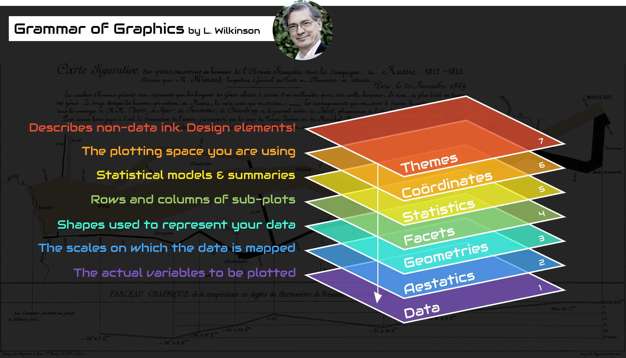
www.cdcs.ed.ac.uk

Slide 19
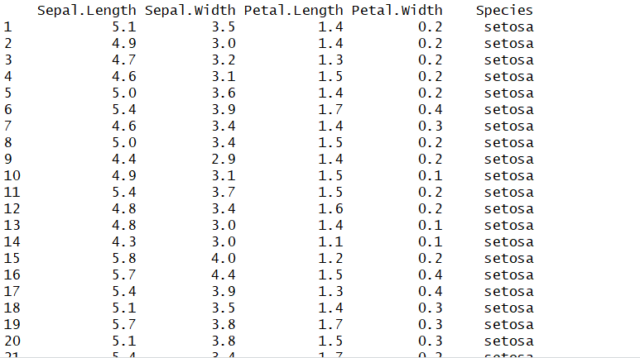
The Data
Level 1: The Dataset I am using
If I want to plot the same type of chart with different data all you have to change is the data reference in the code
www.cdcs.ed.ac.uk

Slide 20
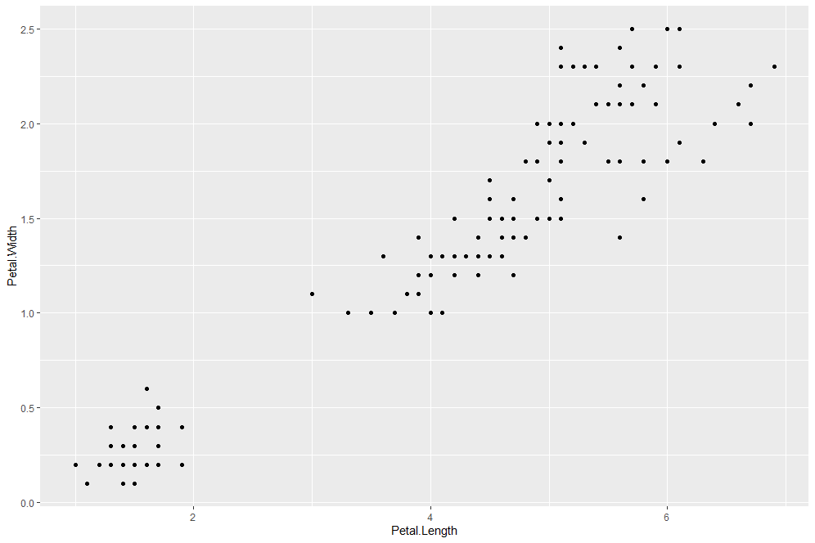
Aesthetics and Geometries
Level 2 and 3
Aesthetics identify which variables I want to work on (depending on the type of chart you are going to work on one or more variables)
Geometries identify the type of chart that I want to produce.
ggplot(iris, aes(x=Petal.Length, y=Petal.Width)) + geom_point()
www.cdcs.ed.ac.uk

Slide 21
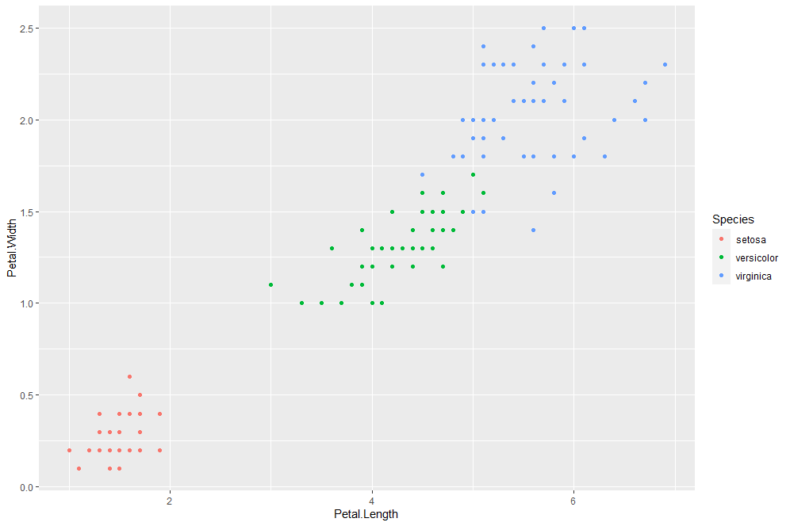
Aesthetics
Level 2
Aesthetics Add a third colour coded variable. Since it is still linked to the aesthetics I need to set it within that part of the code
ggplot(iris, aes(x=Petal.Length, y=Petal.Width, color=Species)) + geom_point()
www.cdcs.ed.ac.uk

Slide 22
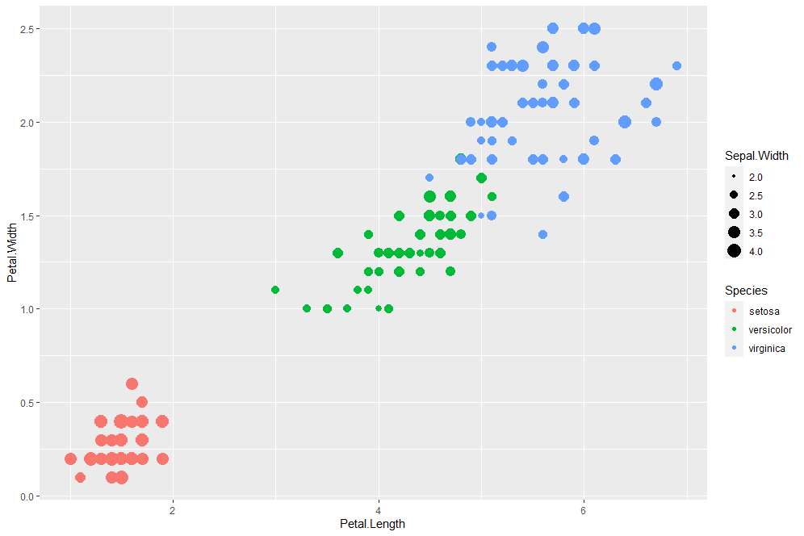
Aesthetics
Level 2
Aesthetics Add a fourth size coded variable. Since it is still linked to the aesthetics I need to set it within that part of the code
ggplot(iris, aes(x=Petal.Length, y=Petal.Width, color=Species, size=Sepal.Width)) + geom_point()
www.cdcs.ed.ac.uk

Slide 23
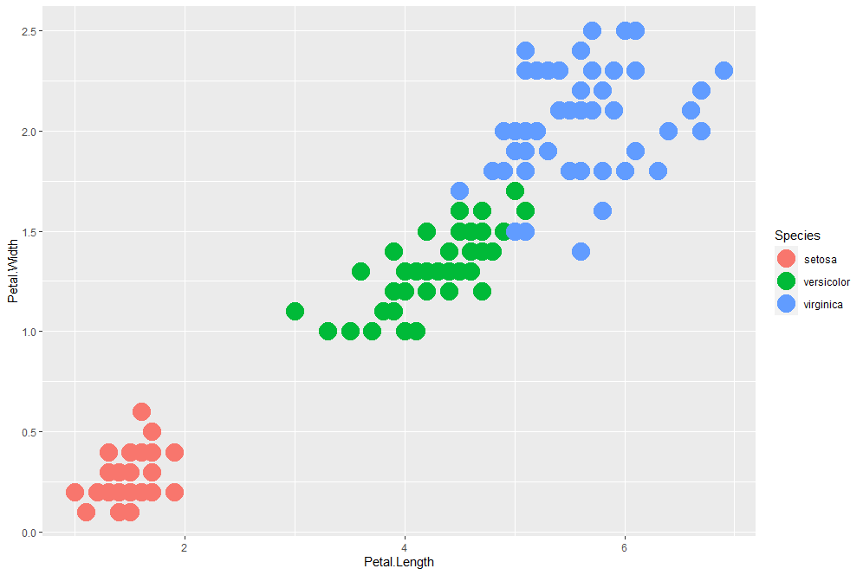
Geometry
Level 3
Geometry. If I just want all the dots to be bigger I shall set the value in the geometry part of the code.
ggplot(iris, aes(x=Petal.Length, y=Petal.Width, color=Species)) + geom_point(size=7)
www.cdcs.ed.ac.uk

Slide 24
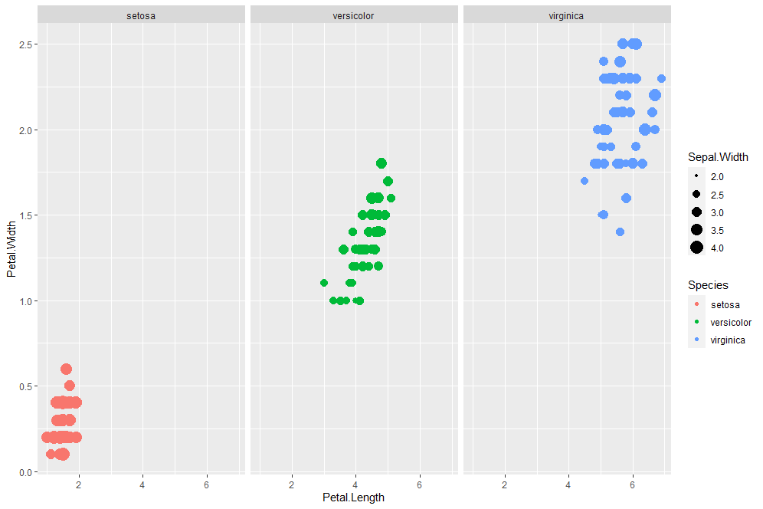
Facet
Level 4 Subplot
Facet. If I just want to visualise the results on separate subplot you need to add this new level of information
ggplot(iris, aes(x=Petal.Length, y=Petal.Width, color=Species, size=Sepal.Width)) + geom_point()+facet_wrap(~Species)
www.cdcs.ed.ac.uk

Slide 25
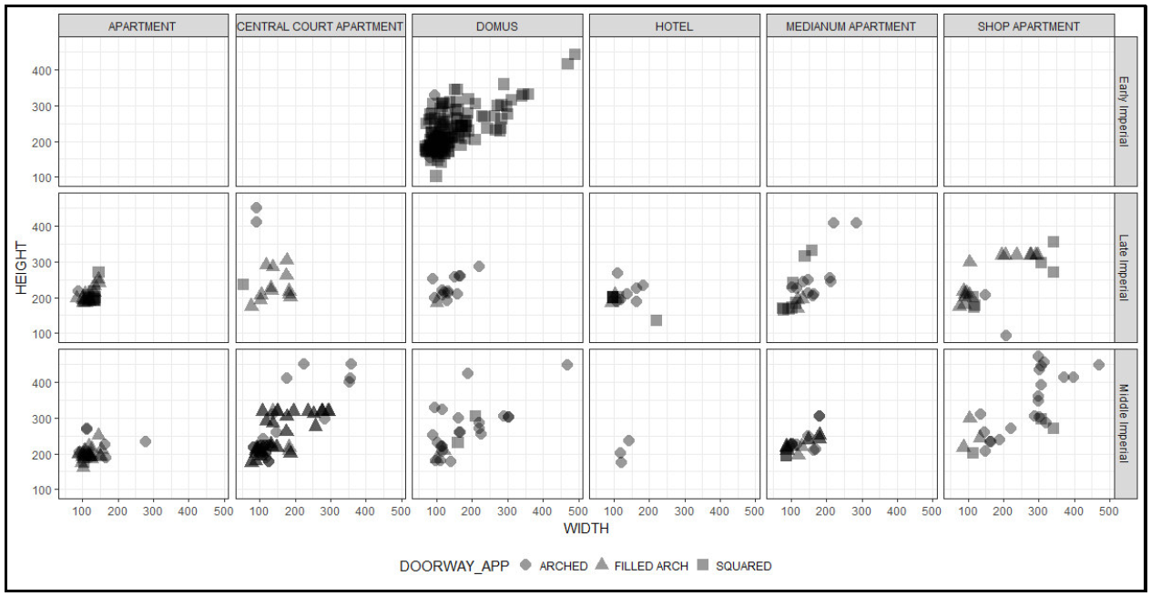
Facet
Level 4 Subplot
Facet. If I just want to visualise the results on separate subplot you need to add this new level of information
If you want to subplot across 2 different variables use facet_grid
ggplot(iris, aes(x=Petal.Length, y=Petal.Width, color=Species, sizcie=Sepal.Width)) + geom_point()+facet_grid(Petal.Width~Spees)
www.cdcs.ed.ac.uk

Slide 26
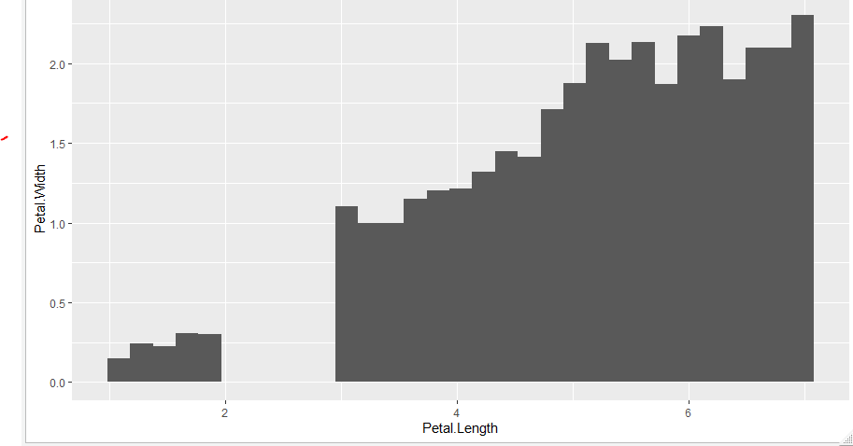
Statistics
Level 5 Summarizing Stats
Instead of the data if you want to plot the summarising of those data you do so using the stats level
ggplot(iris, aes(x=Petal.Length, y=Petal.Width)) + stat_summary_bin(fun.y="mean", geom = "bar")
www.cdcs.ed.ac.uk

Slide 27
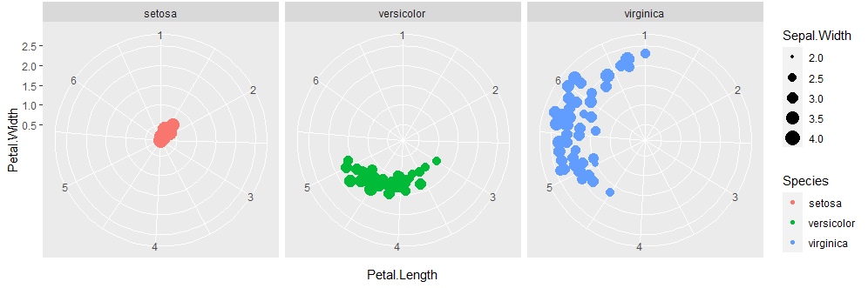
Coordinates
Level 6 Coordinates
On this level you can set the attributes of the coordinates, change the scale or transform in polar
ggplot(iris, aes(x=Petal.Length, y=Petal.Width, color=Species, size=Sepal.Width)) + geom_point()+facet_wrap(~Species)+coord_polar()
www.cdcs.ed.ac.uk

Slide 28
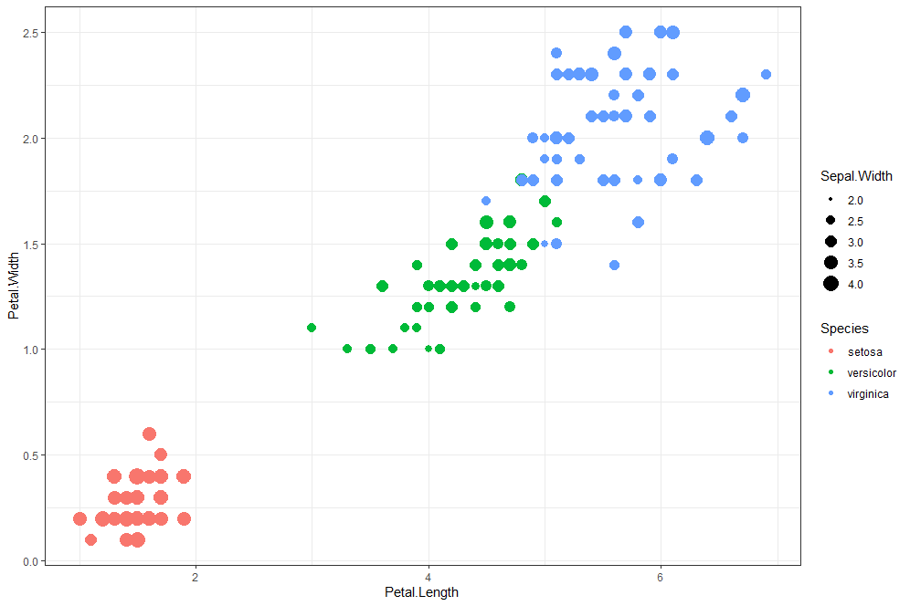
Themes
Level 7 Global settings
Global settings of the charts can be changed in the theme part of the code. All non data ink
ggplot(iris, aes(x=Petal.Length, y=Petal.Width, color=Species, size=Sepal.Width)) + geom_point()+theme_bw()
www.cdcs.ed.ac.uk

Slide 29
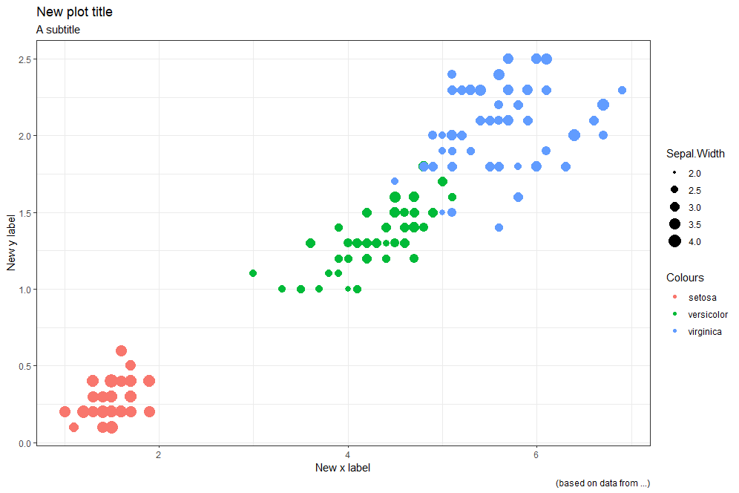
Labels
Level 7 labels
A peculiar setting you want to pay attention to are the lables
ggplot(iris, aes(x=Petal.Length, y=Petal.Width, color=Species, size=Sepal.Width)) + geom_point()+theme_bw() + labs(title = "New plot title", subtitle = "A subtitle", caption = "(based on data from ...)", x = "New x label", y= "New y label", color = "Colours")
www.cdcs.ed.ac.uk

Slide 30
Challenge 1
Create a chart that would show the relationship between the SAT average and the admission rate
Can you see any relationship between the two values?
See if this relationship is also influenced by the type of control of the University "control" and the region where the university is located (tip: you can use the colors to see that).
Plot this last info on separate subplot to better see the trends.
Make sure that the chart has a white background
Give your Graph a title and a subtitle
Rename the x and y axis and add a caption saying that it is based on the data from the University census.
Add some trasparency to better see the overlapping points search here on how to do it
Use Slack to dicuss the your results with the other attendees
www.cdcs.ed.ac.uk

Slide 31
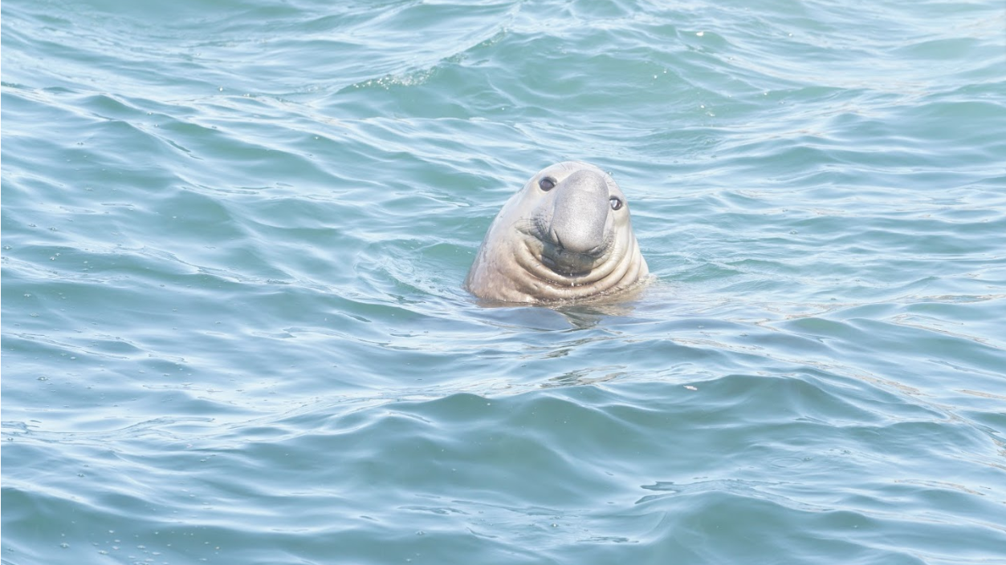
Any Question?
www.cdcs.ed.ac.uk

Slide 32
Next Class
Discuss the results of the challenge
Intro to Statistics
Descriptive Statistics
Summarising Statistics
Exploring 1 variable: Plotting distribution Histograms and Denstiy plot
www.cdcs.ed.ac.uk

Slide 33
References
Data Wrangling
https://programminghistorian.org/en/lessons/data_wrangling_and_management_in_R
https://datacarpentry.org/r-socialsci/03-dplyr-tidyr/index.html
https://www.linkedin.com/learning/data-wrangling-in-r/welcome?u=50251009
https://datacarpentry.org/R-ecology-lesson/03-dplyr.html
Plotting with R and R studio
https://rstudio.com/wp-content/uploads/2016/11/ggplot2-cheatsheet-2.1.pdf
https://ggplot2.tidyverse.org/index.html
https://datacarpentry.org/r-socialsci/04-ggplot2/index.html
http://www.sthda.com/english/wiki/be-awesome-in-ggplot2-a-practical-guide-to-be-highly-effective-r-software-and-data-visualization
https://www.linkedin.com/learning/r-essential-training-wrangling-and-visualizing-data/introduction-to-ggplot2
https://r4ds.had.co.nz/data-visualisation.html
https://r-graphics.org/
Grammar of Graphics
https://www.slideshare.net/kesarifms/grammar-of-graphics-the-secret-sauce-of-powerful-data-stories
https://www.linkedin.com/learning/data-visualization-in-r-with-ggplot2/the-grammar-of-graphics
https://onlinelibrary-wiley-com.ezproxy.is.ed.ac.uk/doi/full/10.1002/wics.118
www.cdcs.ed.ac.uk

